Slide 1
DEVOPS
AI-Powered Urban Operations Command Center
integrating, testing, and deployment of all services using CI/CD pipelines and AWS infrastructure.

Slide 2
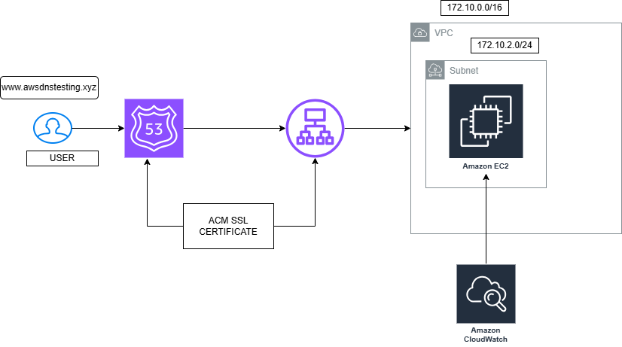
AWS INFRASTRUCTURE

Slide 3
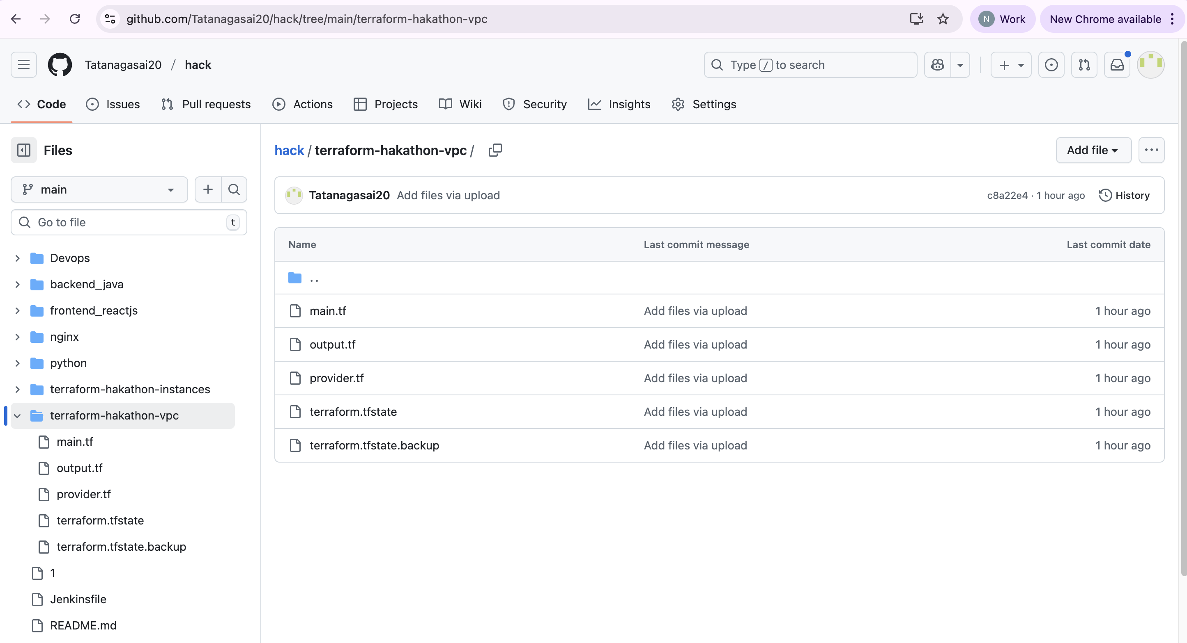
TERRAFROM INFRA SETUP
For VPC:

Slide 4
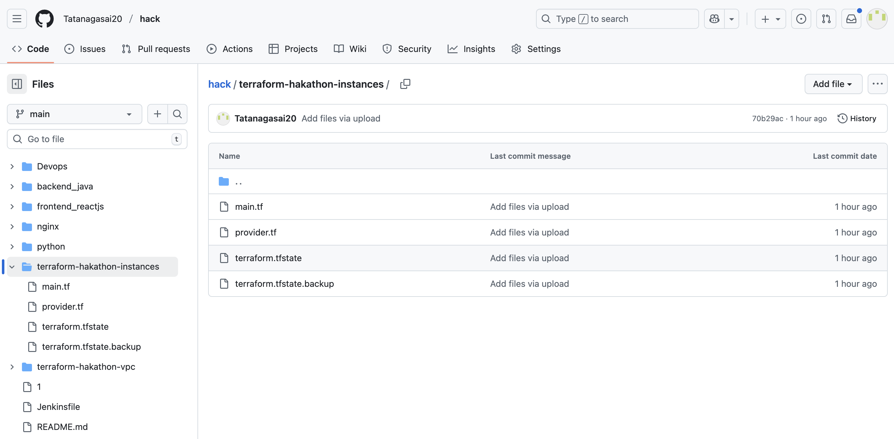
FOR INSTANCE:

Slide 5
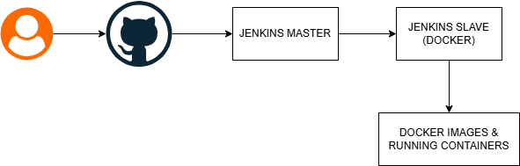
Devops workflow

Slide 6
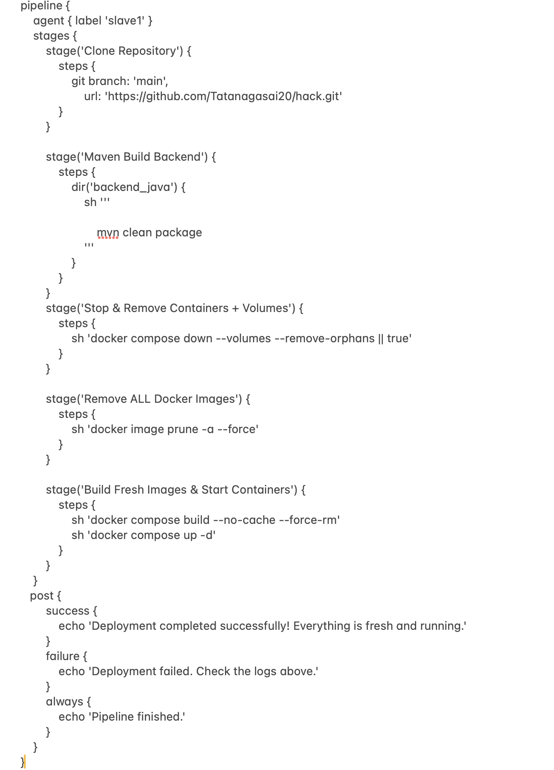
JENKINS CI/CD

Slide 7
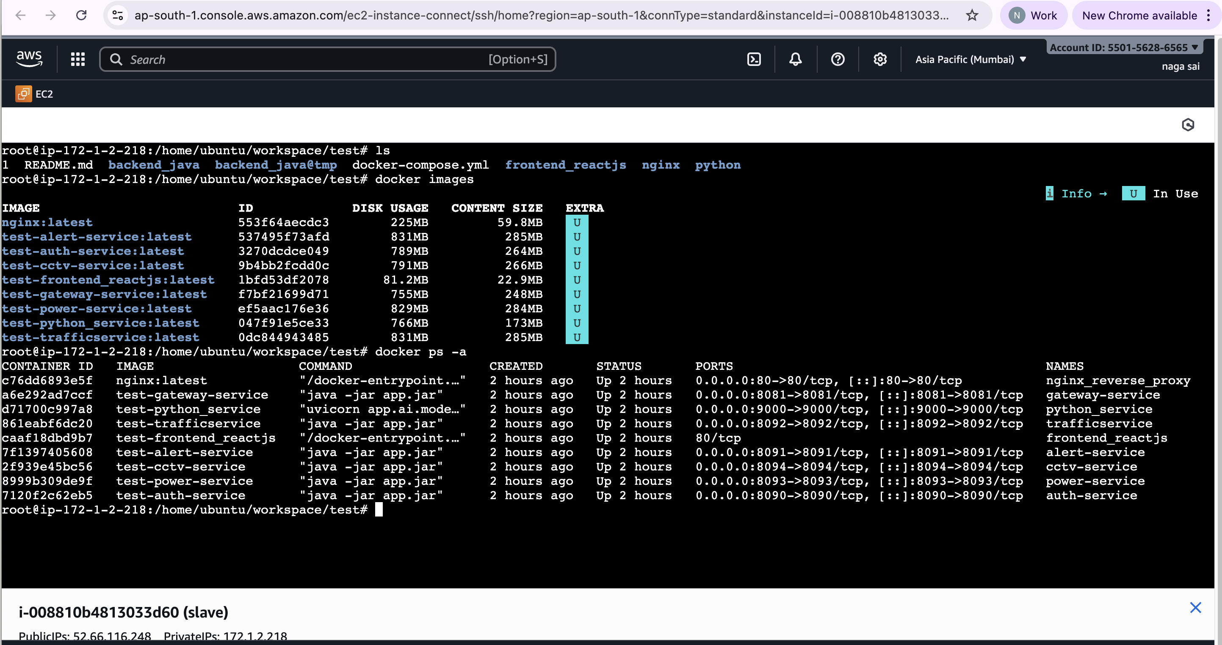
DOCKER IMAGES AND CONTAINERS

Slide 8
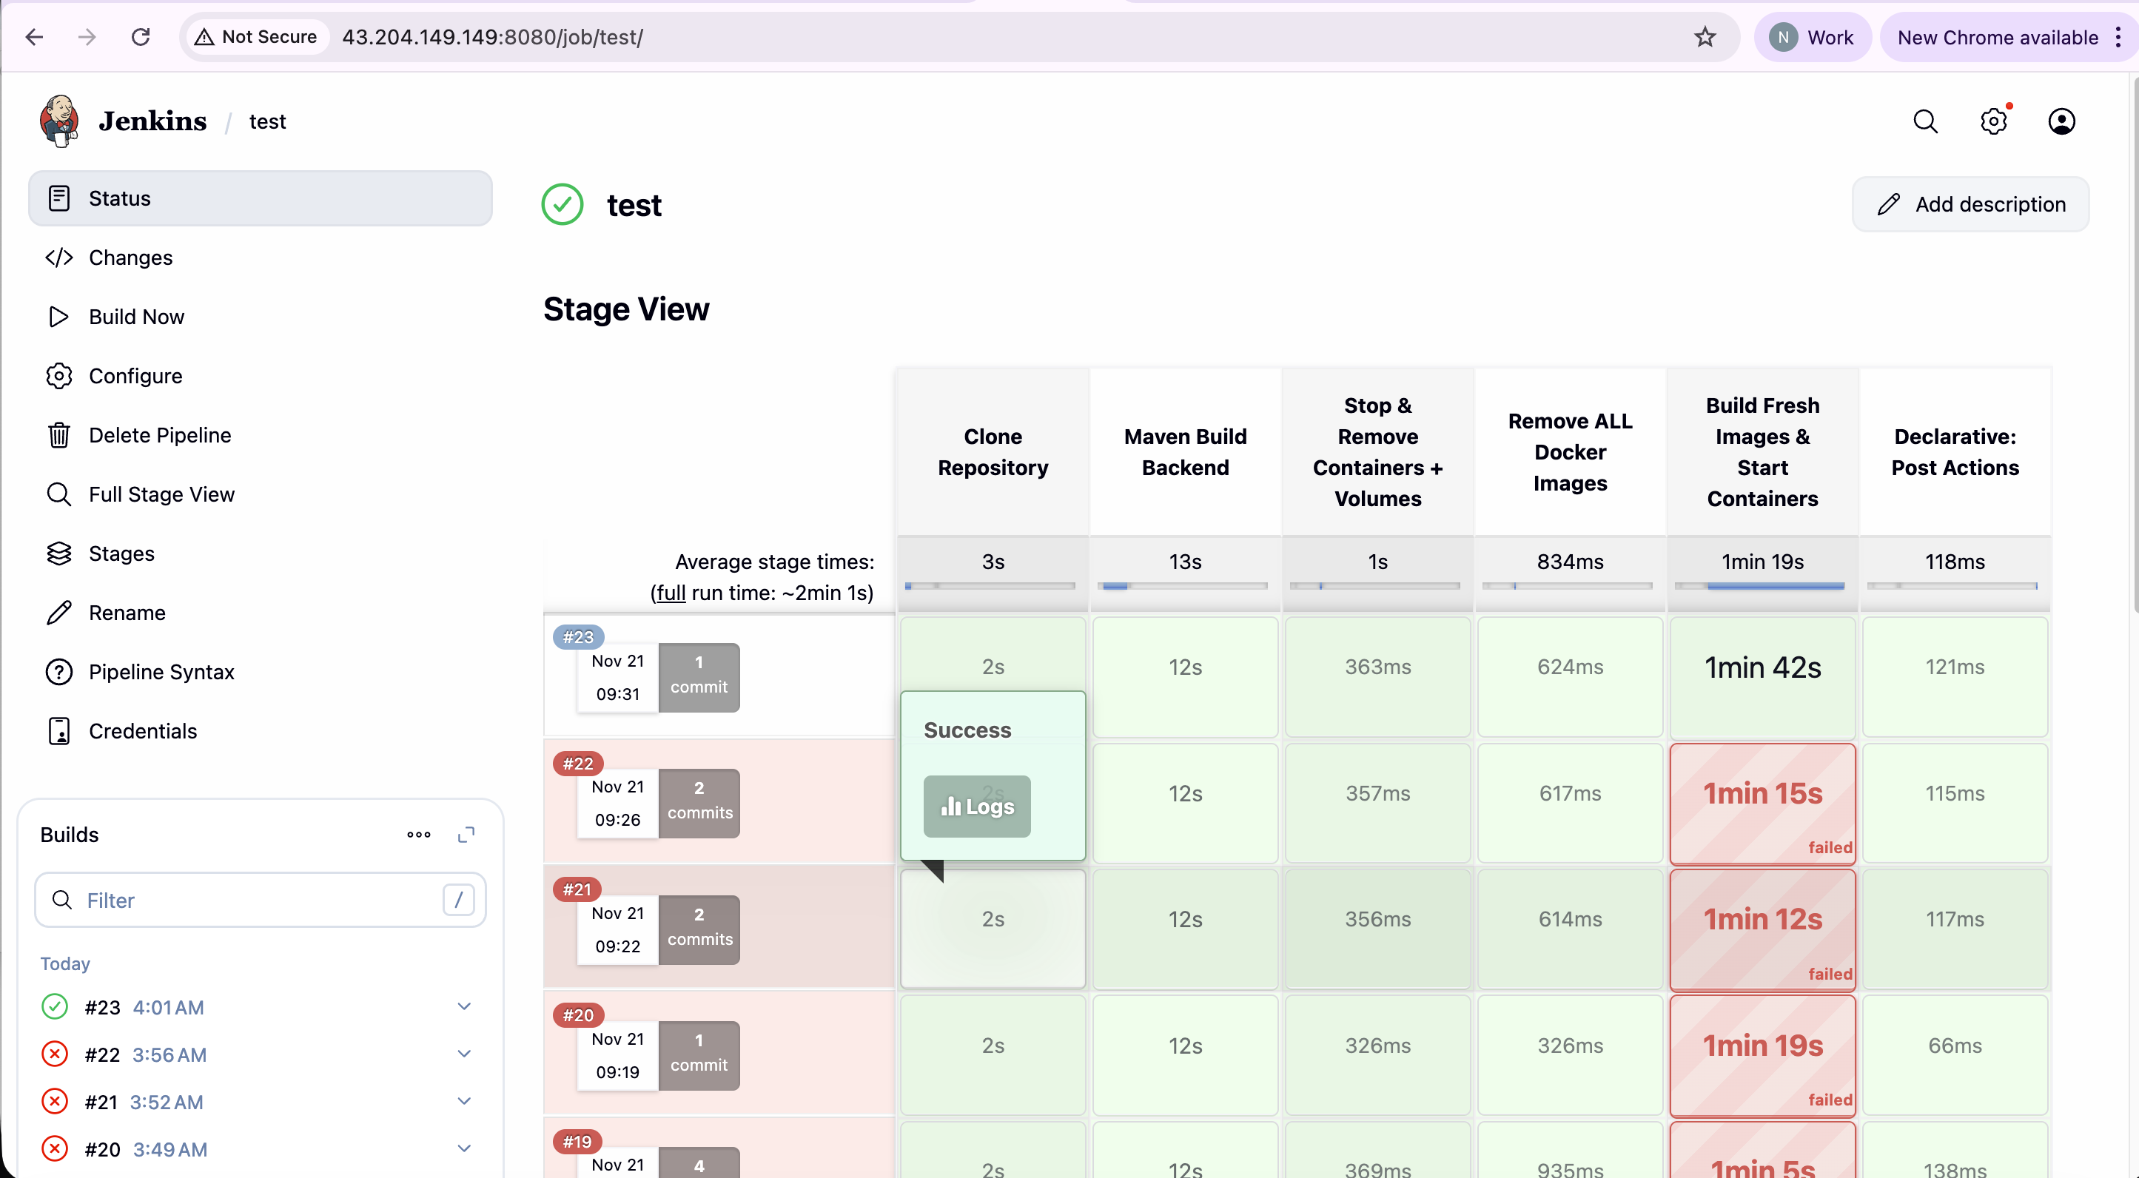
JENKINS OUTPUT

Slide 9
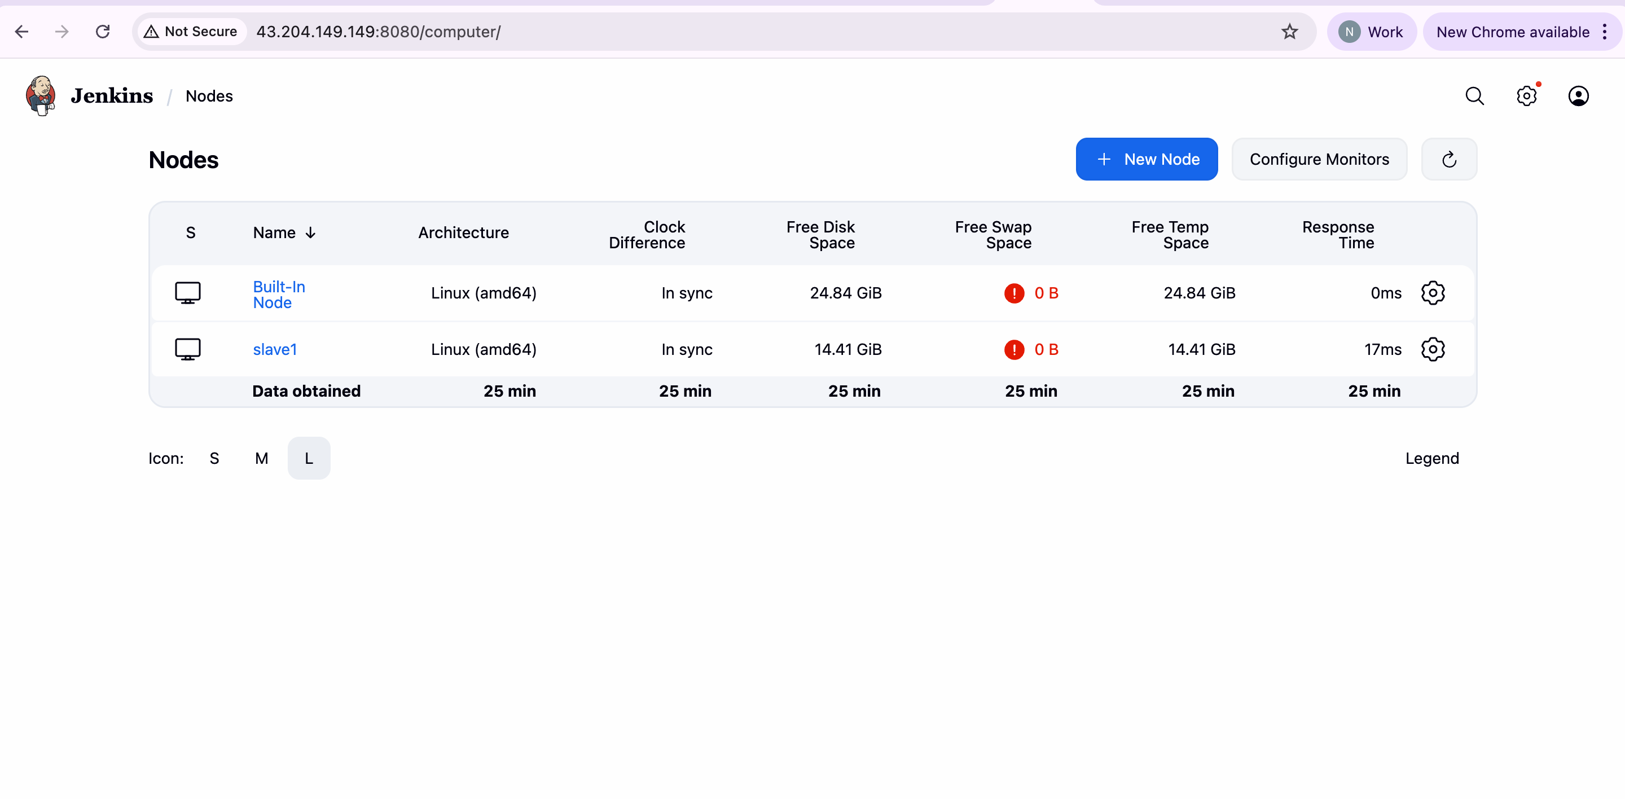
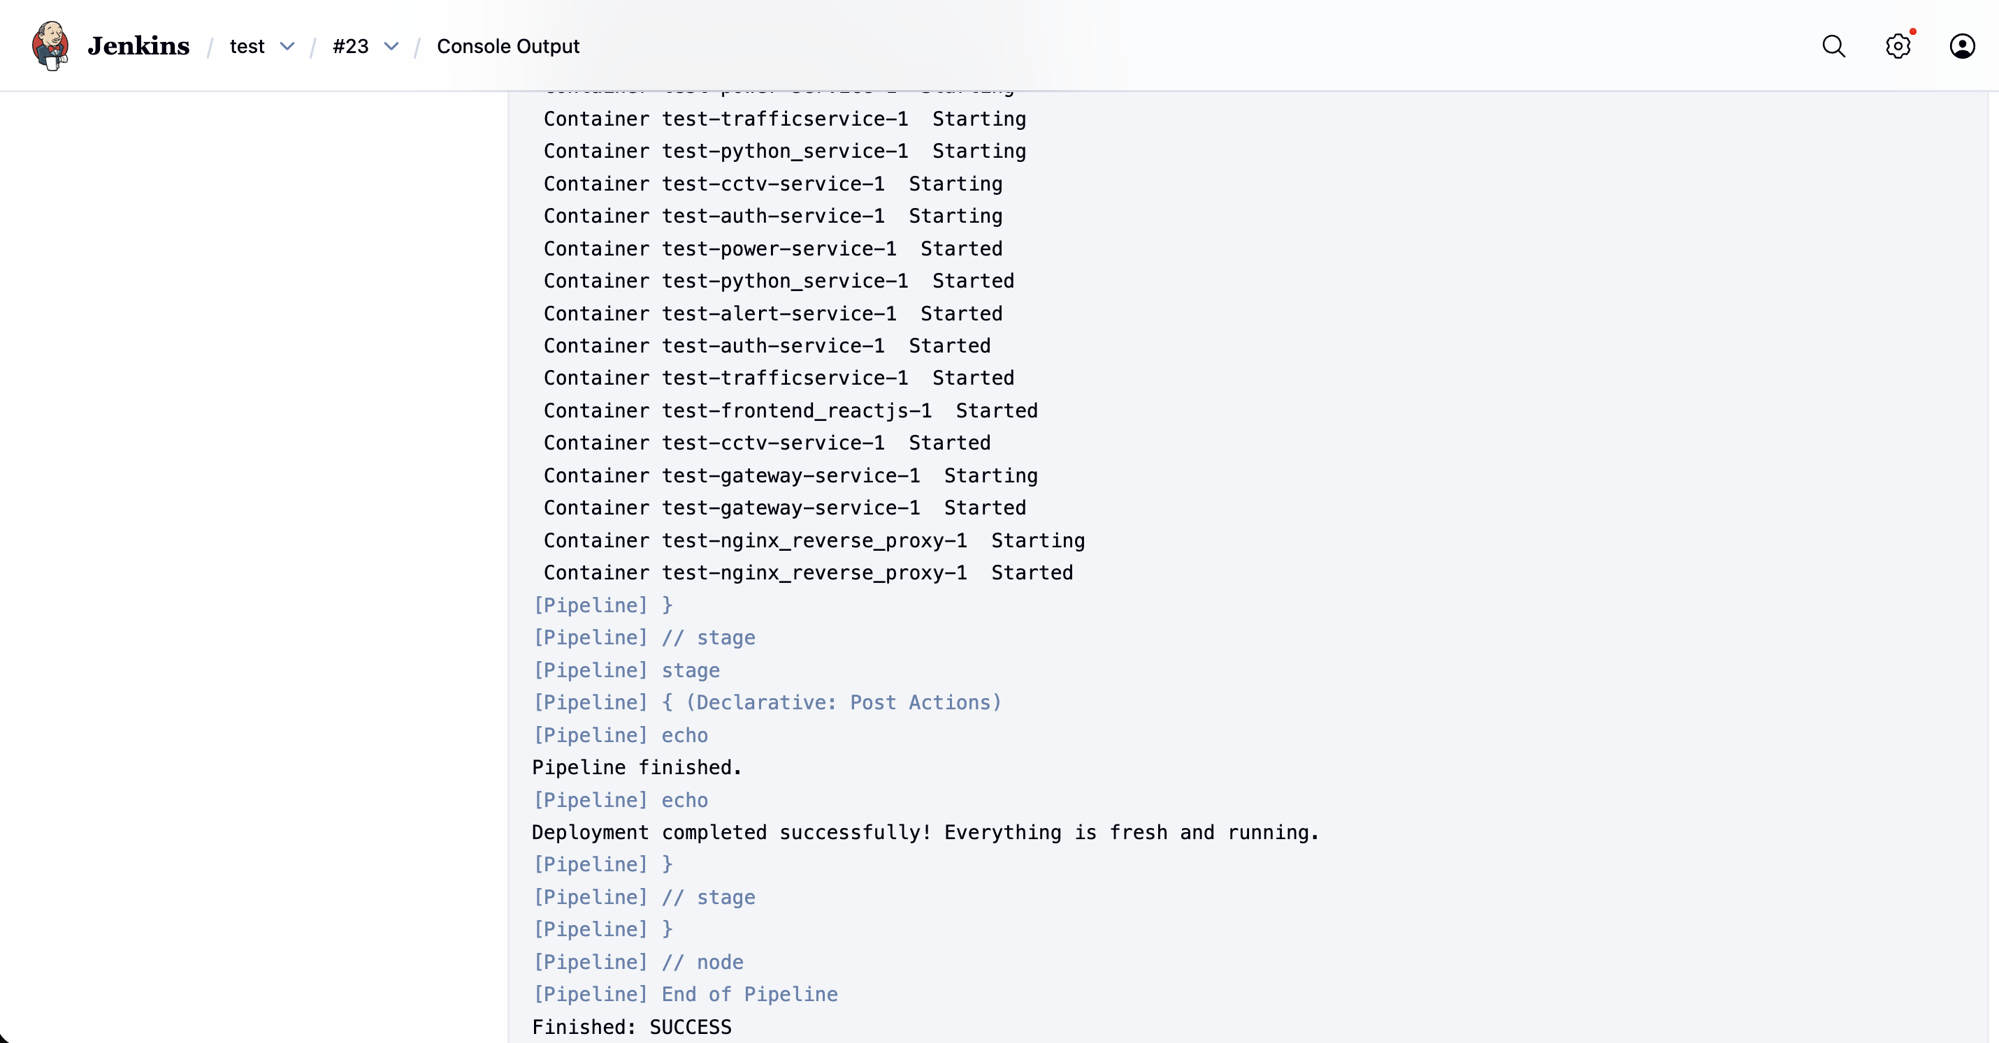
MASTER SLAVE SETUP
JENKINS LOGS OUTPUT

Slide 10
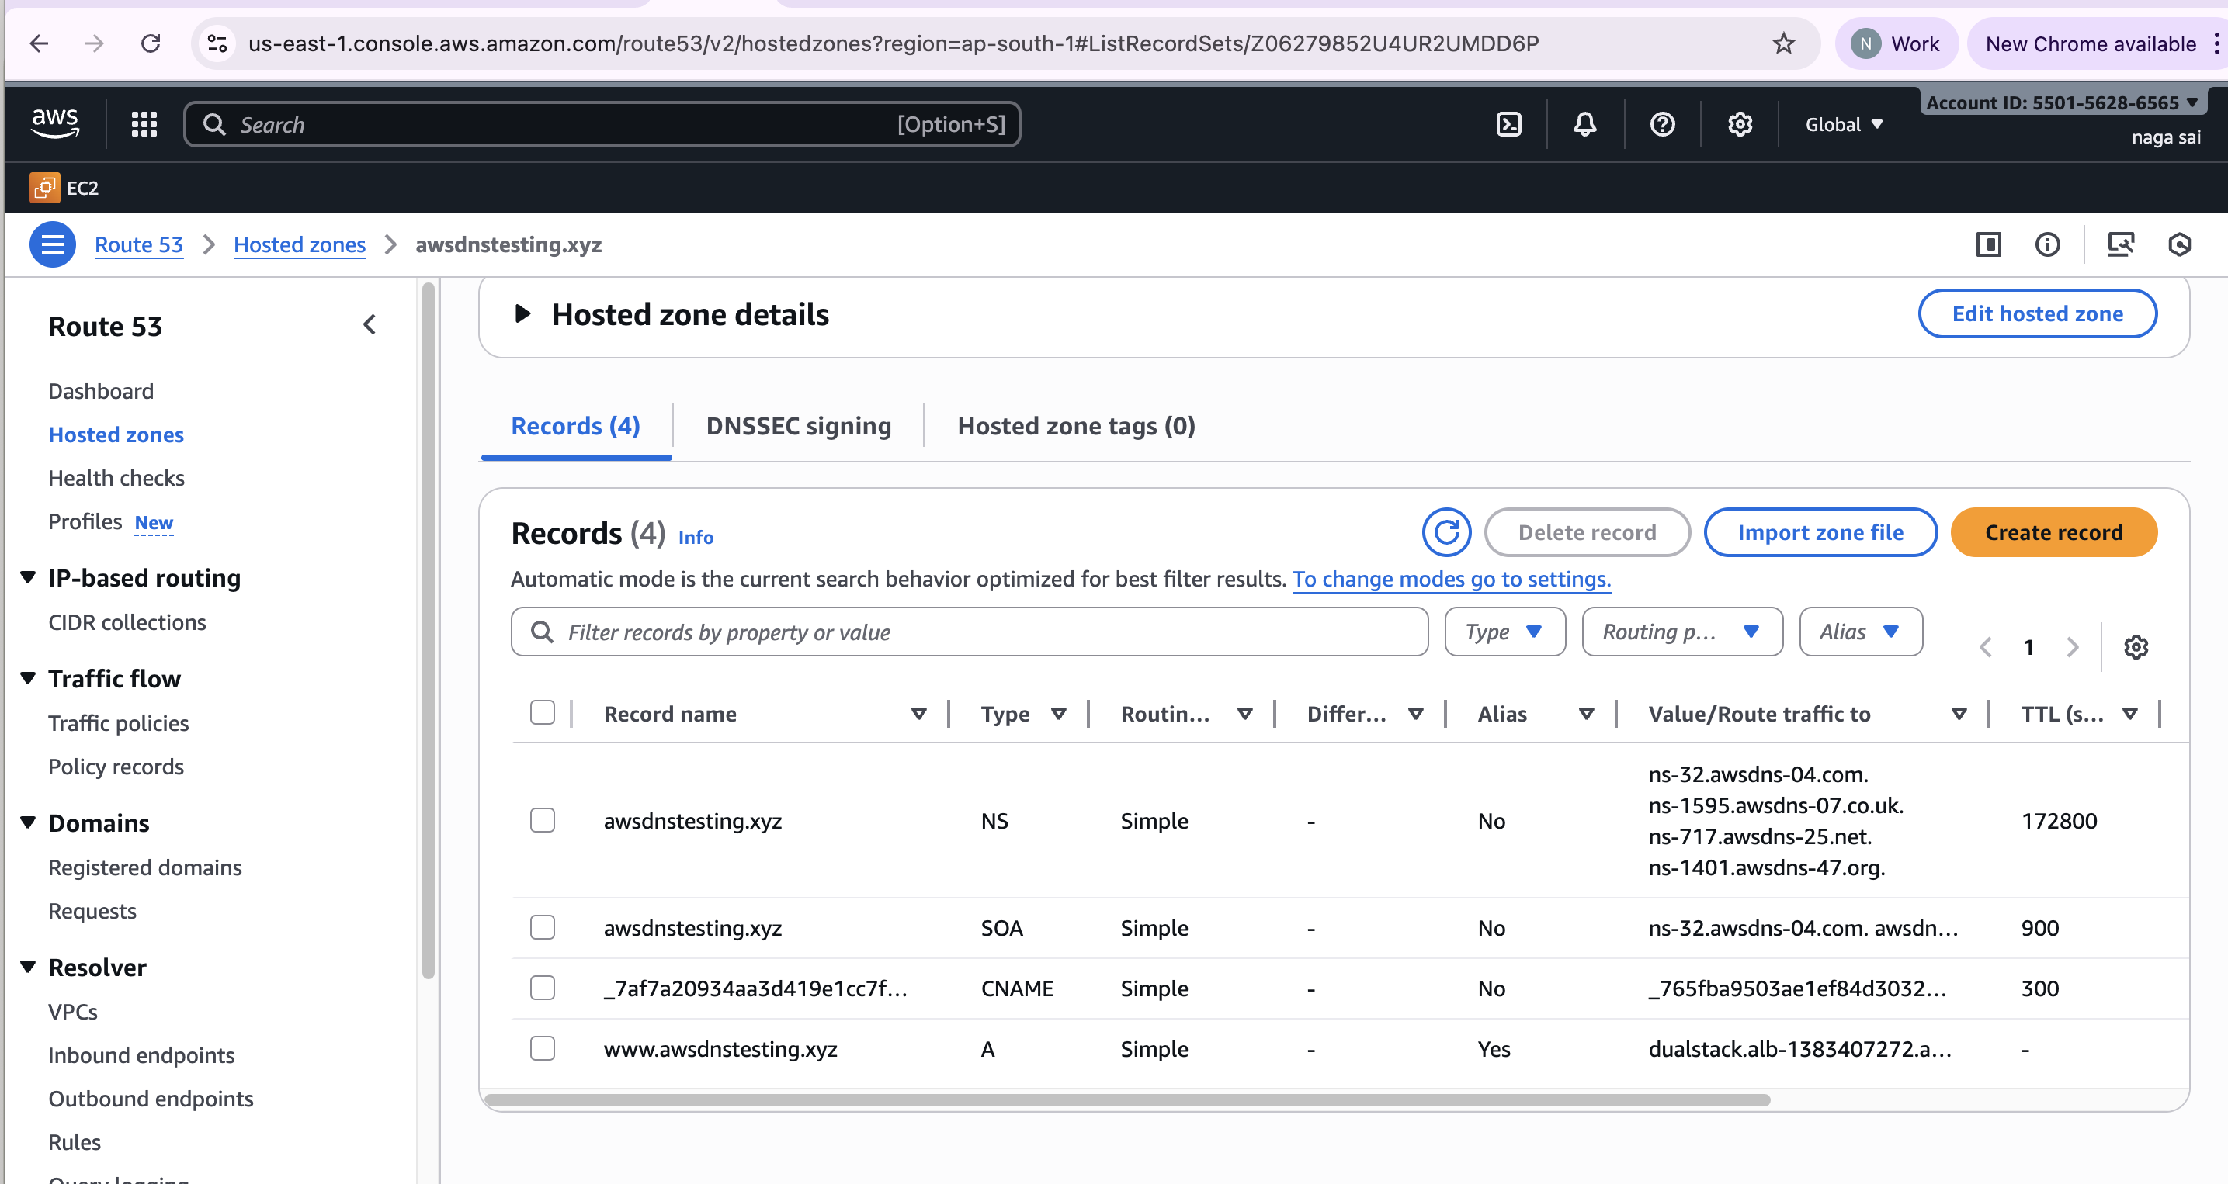
ROUTE53 WITH DNS ADDING ACM FOR SSL

Slide 11
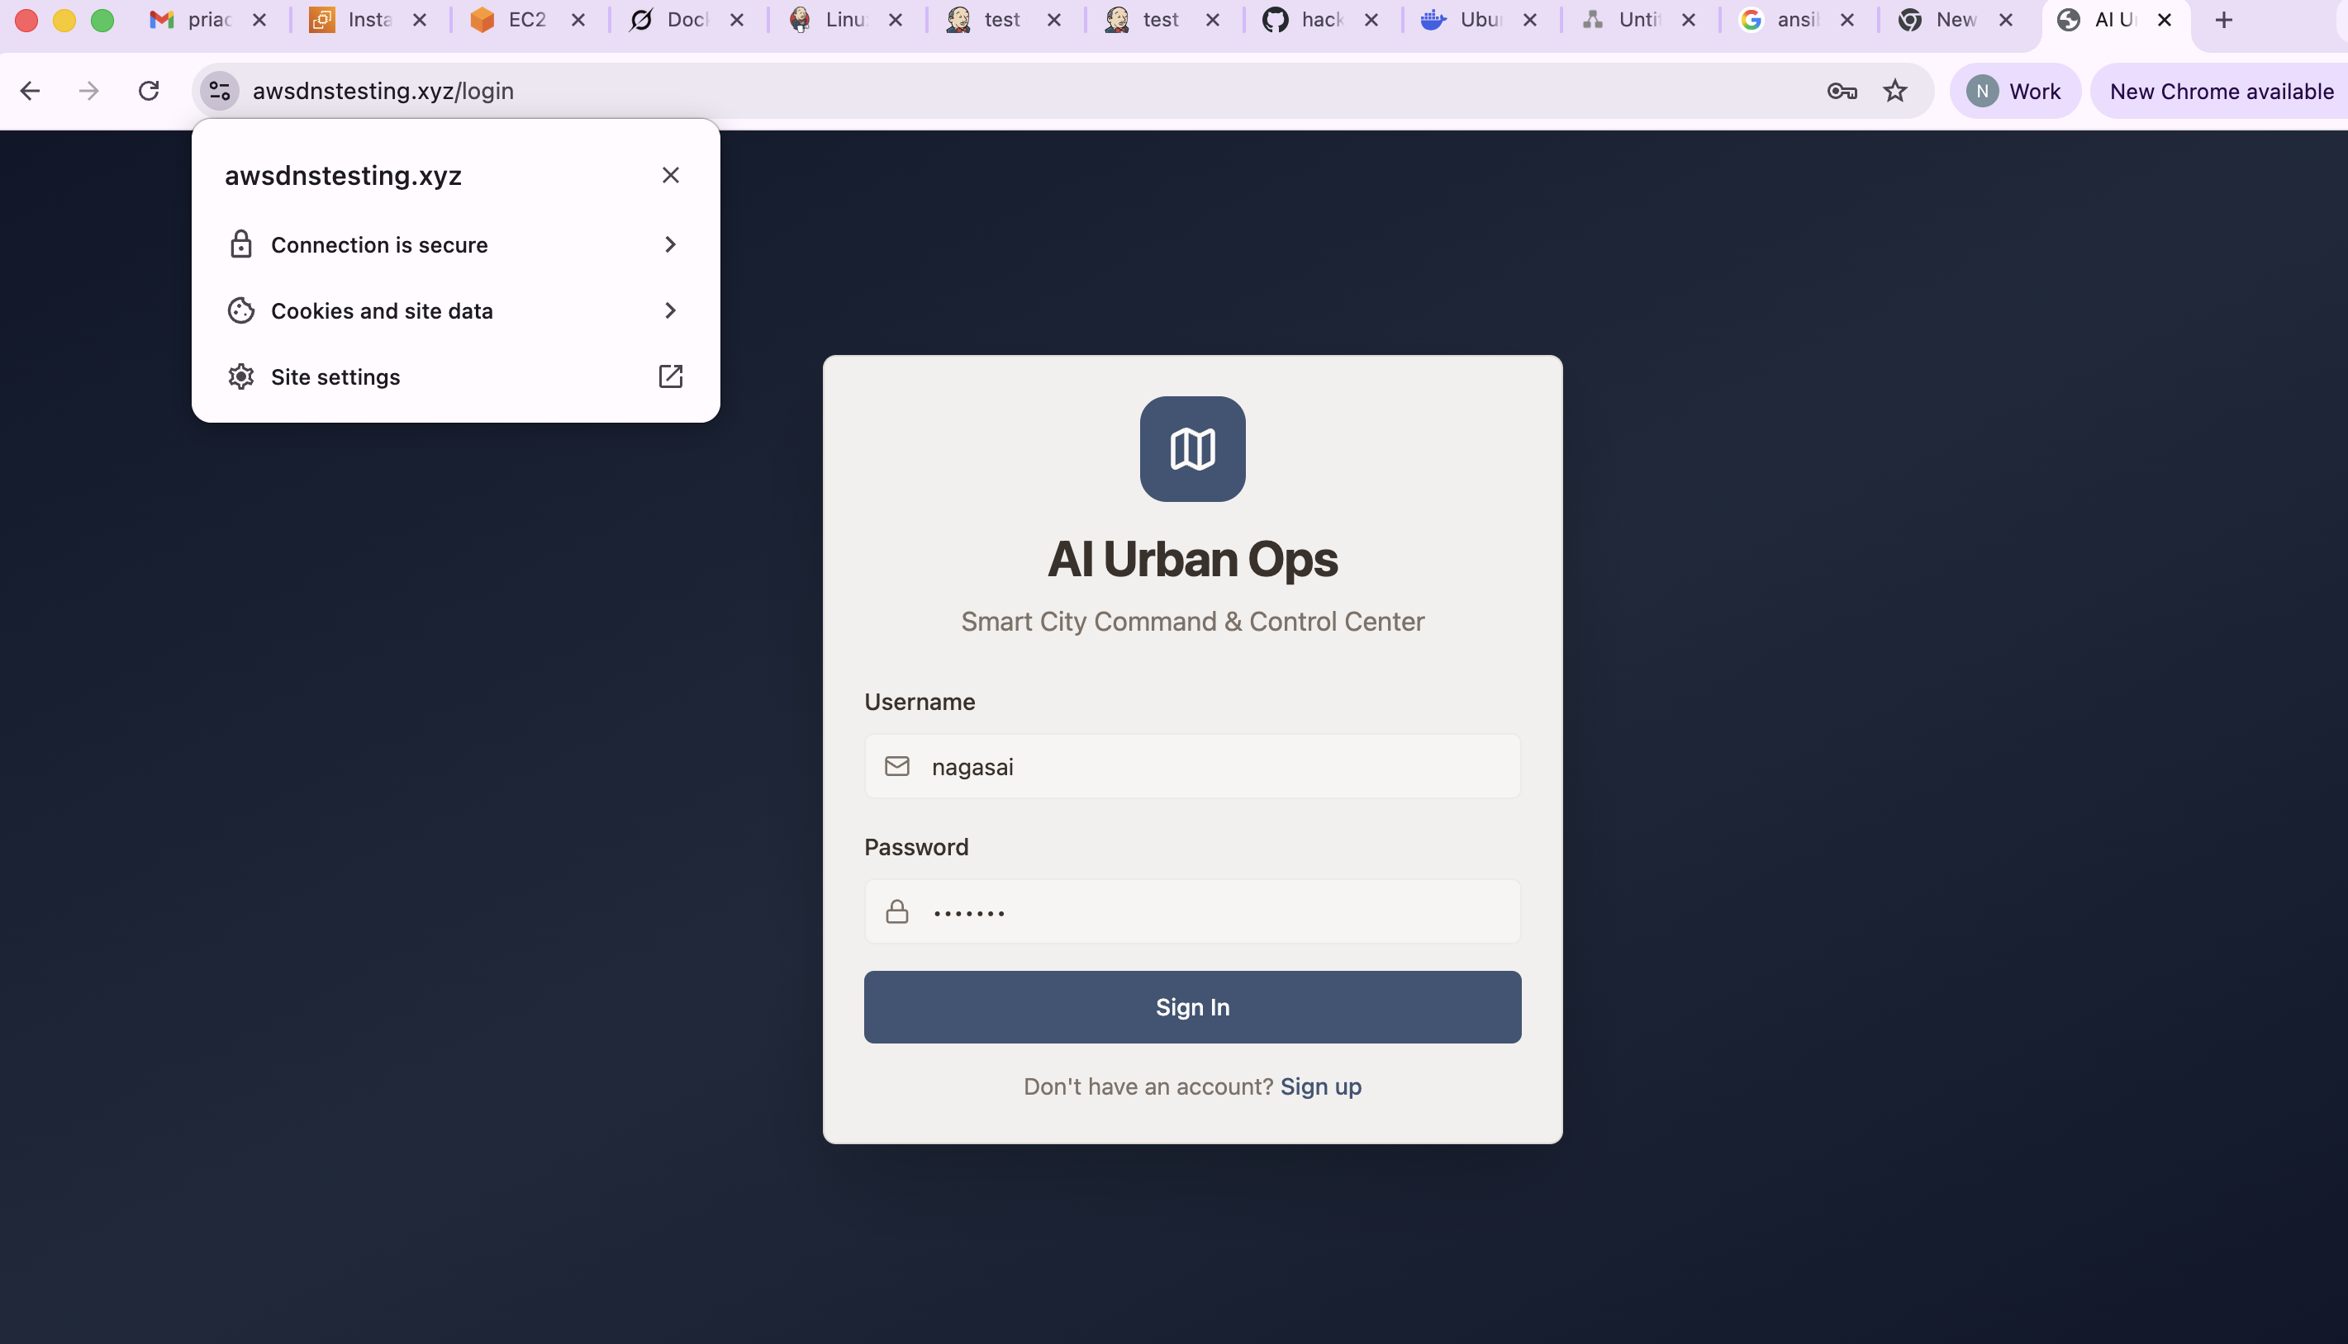
OUTPUT

Slide 12
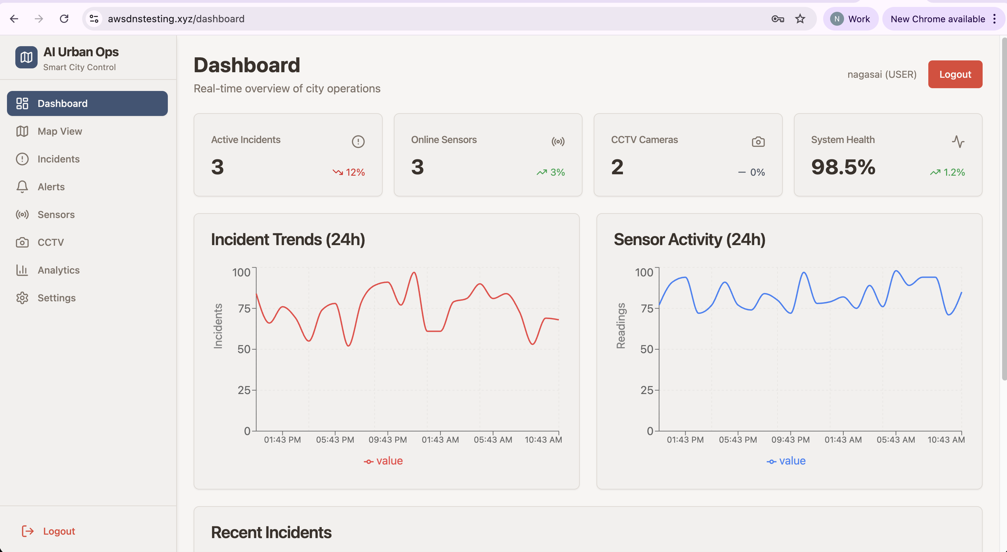
DASHBOARD

Slide 13
THANK YOU

